Slide 1
PRESENTATION ON TO-DO APP
Presented by
Amena Akter Asha 1902012
Aktara Yasmin Bithi 1902016
Noman Zuhaer Antor 1902035
Course Code: CSE 420
Course Title: System Analysis and Design Sessional
HAJEE MOHAMMAD DANESH SCIENCE AND TECHNOLOGY UNIVERSITY,
DINAJPUR-5200

Slide 2
OUTLINE
Introduction
Features
Objectives
Life Cycle Model
Design & Implementation
Importance
Conclusion

Slide 3
INTRODUCTION
To Do App is a mobile application. The name of the language used for this application is Dart. This application contains
Activities of our daily life
Time schedule for Meeting or other activities

Slide 4
Features
Saving Daily Activities
Fixed schedule for another or far days
Allows editing the activity after creation
Auto deletion of schedule
Refreshing schedule

Slide 5
OBJECTIVE
Help us become more aware of how we spend time in the process of doing a specific tasks .
Makes it easier to get work done and makes it harder to miss deadlines.

Slide 6
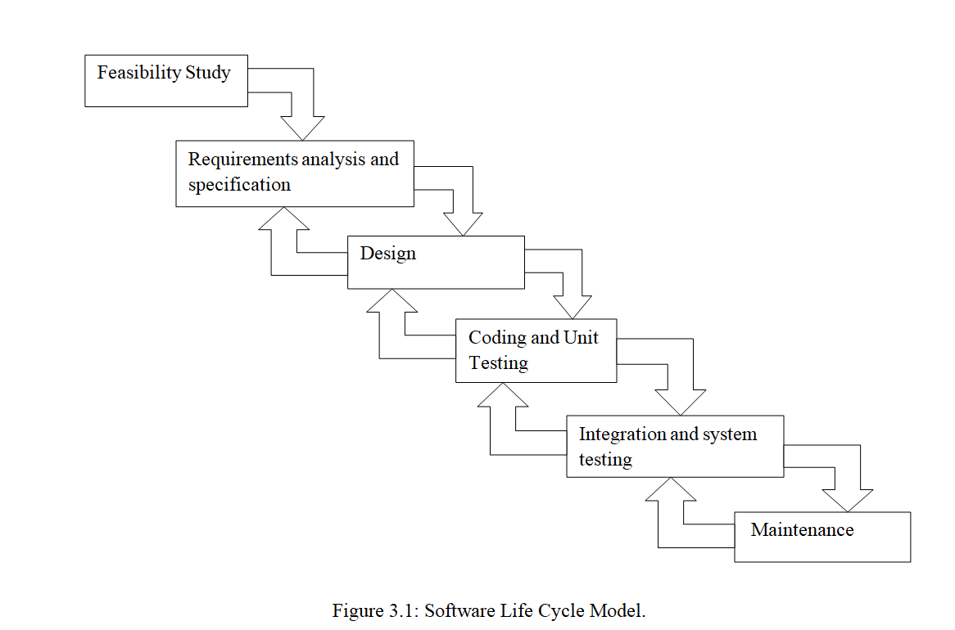
SOFTWARE LIFE CYCLE MODEL

Slide 7
DESIGN & IMPLEMENTATION
Starts from a simple image page.
Todo is the homepage.
SQFlite database is used for storing information.
Another dart file is used to initialize the database and hold the CRUD operation.

Slide 8
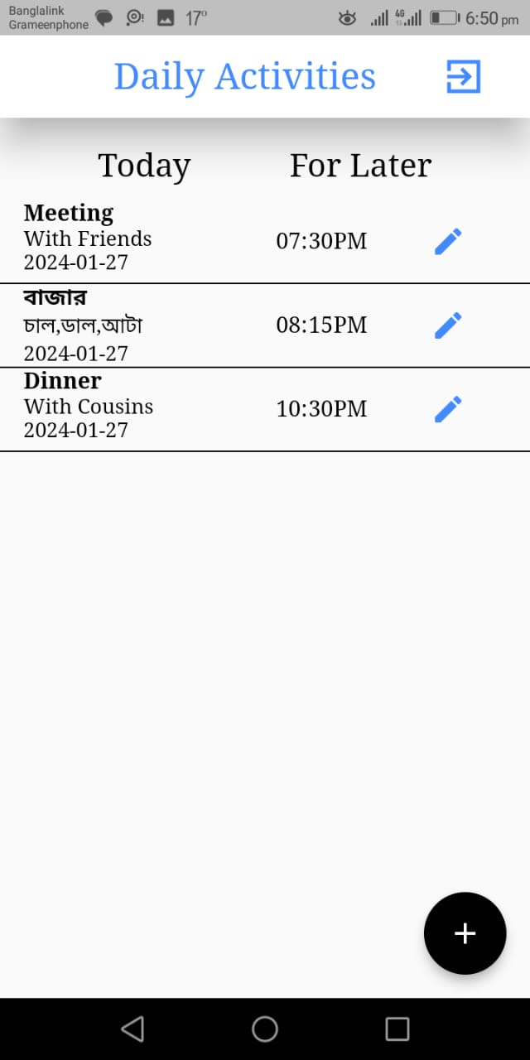
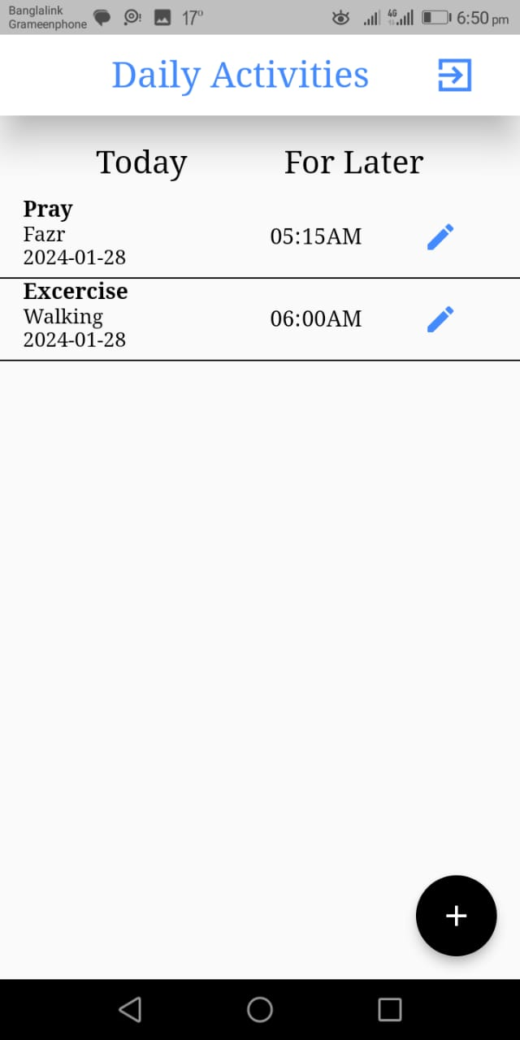
DESIGN & IMPLEMENTATION

Slide 9
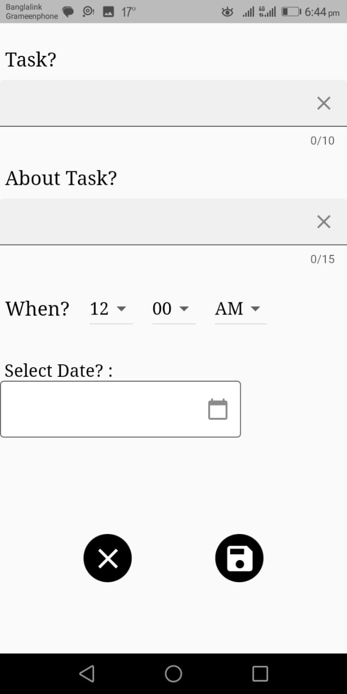
DESIGN & IMPLEMENTATION
This is the Add activity page.
On this page, Fields are required to be filled.
Various conditions on time & date are applied here
Adds the information to the database

Slide 10
DESIGN & IMPLEMENTATION
Constraints for Schedules
All information should be filled
Selected time must be greater than the real time
Previous dates will be disabled

Slide 11
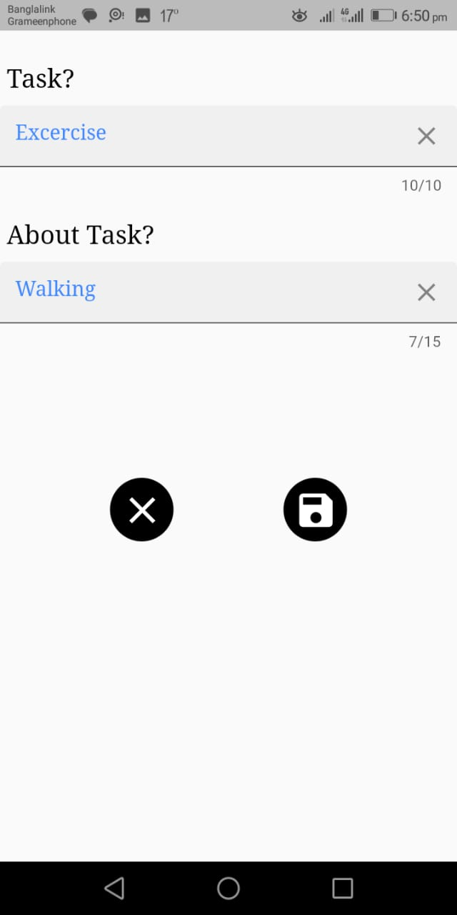
DESIGN & IMPLEMENTATION

Slide 12
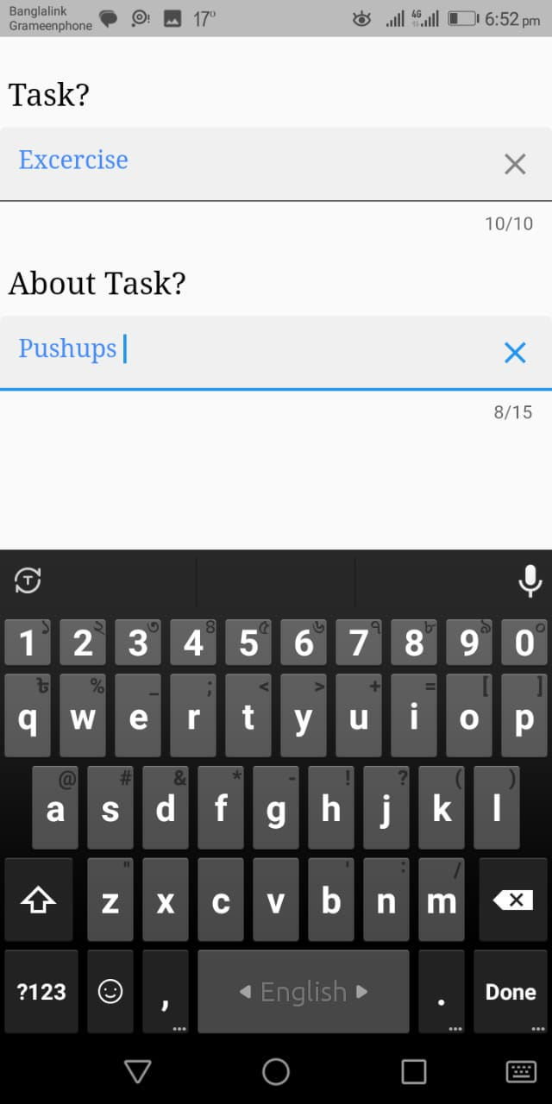

DESIGN & IMPLEMENTATION

Slide 13
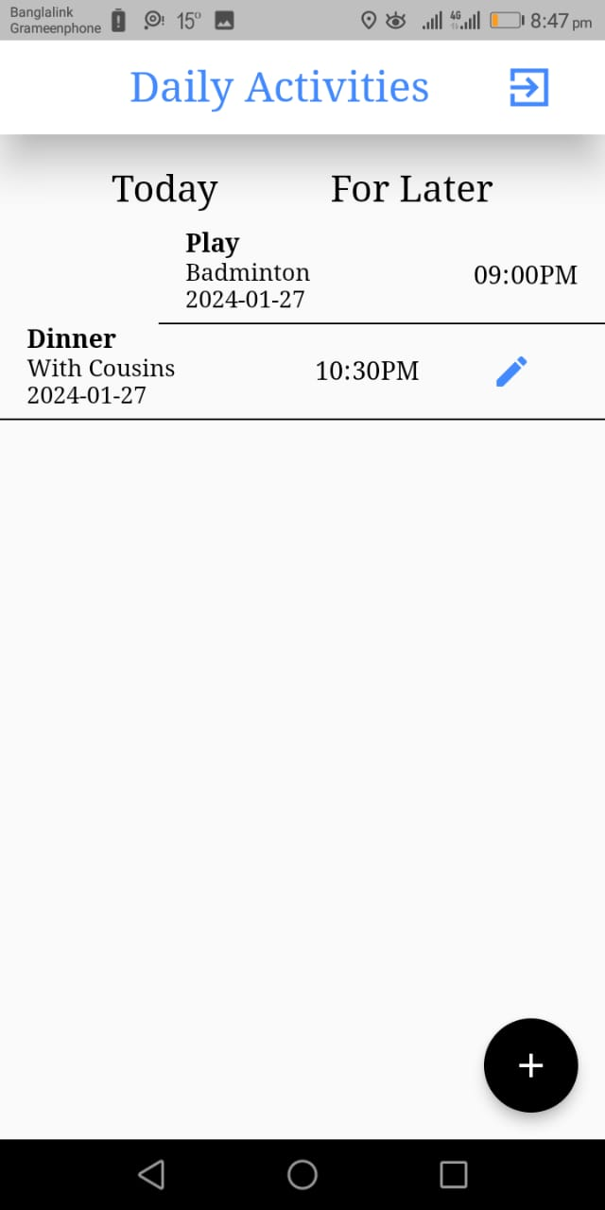
DESIGN & IMPLEMENTATION
Deletion/Completion of a task is performed by swiping right to the screen
Auto Deletion of task is performed when the schedule time or date is expired
Beside this, it supports refresh page operation

Slide 14
IMPORTANCE
Reduce stress for a busy working schedule
Higher productivity to better mental health.
Productive at work and enjoy your personal time
Can help us to track your short-term goals, ideas, and, accomplishments.

Slide 15
CONCLUSION
To Do app performs very efficient comparing to competitor. There is a space for further developments with regards of keeping app small and quick.
Limitation
It can not gives alarm to the user for nearly executing task
It can not handle multiple user from a single device

Slide 16
CONCLUSION
Future Enhancement
Making the user interface more delighted
Adding user account
Make the user notified before auto deletion of a task

Slide 17
THANK YOU

